Slide 1

Team 9:
Khushbu Parekh
Tapadyuti Maiti
Under the guidance of:
Prof. Shrikanth Krishnamurthy

Slide 2
Introduction
Apache Spark as a fast and general engine for big data processing.
It has built-in modules for streaming, SQL, machine learning and graph processing.
It’s well-known for its speed, ease of use, generality and the ability to run virtually everywhere.
Data scientists can benefit from Spark when doing exploratory data analysis, feature extraction, supervised learning and model evaluation.

Slide 3
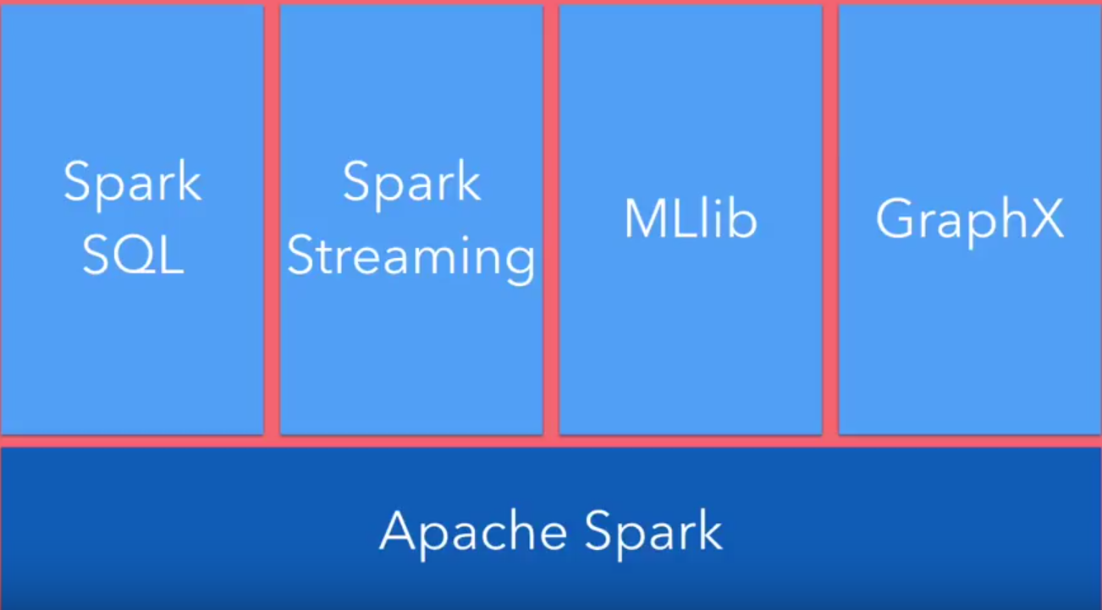
All in one Solution

Slide 4
RDD Basics
RDD is the spark’s core abstraction which is resilient distributed dataset.
Resilient means the ability to be recomputed from history.
It is the immutable distributed collection of objects.
Immutable – cannot be modified
distributed – it is distributed to various nodes in a cluster.
Internally spark distributes the data in RDD, to different nodes across the clusters to achieve parallelization.
Data in the RDD is partitioned and each partition is fed to different nodes across the cluster.
Operation performed on RDD are done in parallel.

Slide 5
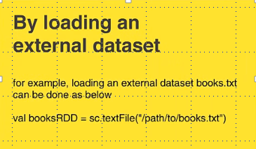
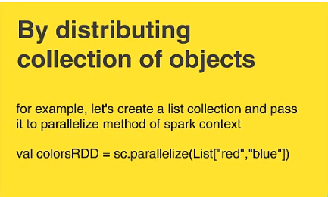
RDD Creation
RDD can be created in 2 ways :
By loading external dataset
By parallelizing an existing collection

Slide 6

RDD Operations
Two types of RDD operations:
RDD Transformation
Transformation is what you do to RDD to get another resultant RDD
e.g. : filter(), union()
Always returns RDD.
RDD Actions
Actions return a result to the driver program or write it in a storage and kick off a computation.
e.g. : count(), first(), collect(), take()
Collect function should not be used on large dataset because the entire data should fit in memory on single machine.
Always returns some other datatype

Slide 7
Basic RDD Transformations:
Map :
map() is the transformation that takes a function and applies the function to each element of input RDD.
Filter :
filter() is the transformation that returns a new RDD with only the elements that passes the filter condition.
Flatmap :
flatmap() is the transformation that takes a function and applies the function to each element of input RDD.
The difference between flatmap() and map() is that flatmsap() will return multiple values for each in the source RDD

Slide 8
Apache Spark Components:
Drivers :
This is process where the main method of your program runs
Driver first coverts the user program into tasks and sends them to worker nodes.
Workers :
These are called the compute nodes.
Executers :
These are the JVM processes within worker nodes.
They run the task of the application and returns the result to the driver program.
They provide in-memory storage for RDD’s that are cached by user program.
Cluster Manager :
It is an external service that launches application on a set of machines.
Spark comes with a built-in cluster manager called standalone cluster manager.
External cluster manager like: Hadoop yarn, Apache mesos.

Slide 9
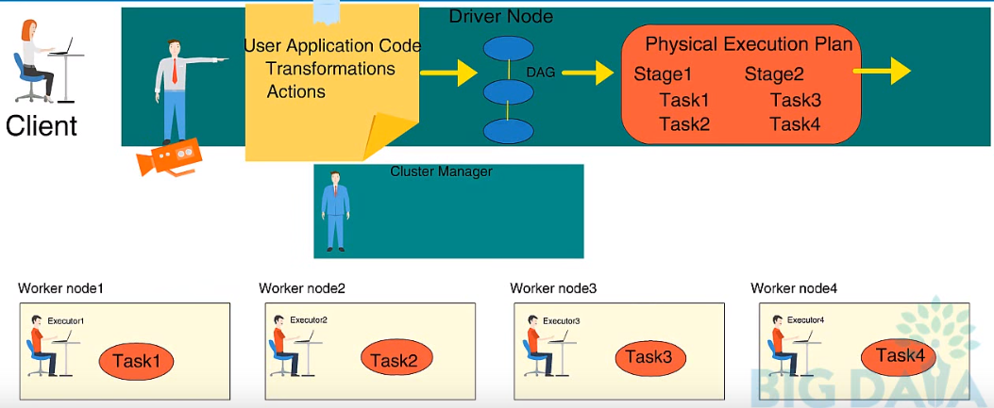
Runtime Architecture of Spark Application:

Slide 10
What Language to use:
Python
Scala

Slide 11
All in one Solution

Slide 12
Spark MLlib
Basic Statistics
Classification and regression models
Clustering: k-means , Gaussian models
Dimensionality reduction
Feature extraction and transformation
Optimisation

Slide 13
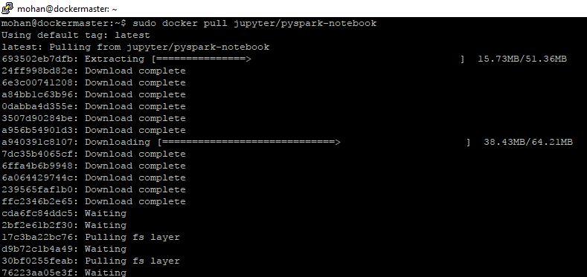
Installation in Docker
Pull the image from the docker by giving the following command:
docker pull jupyter/pyspark-notebook

Slide 14
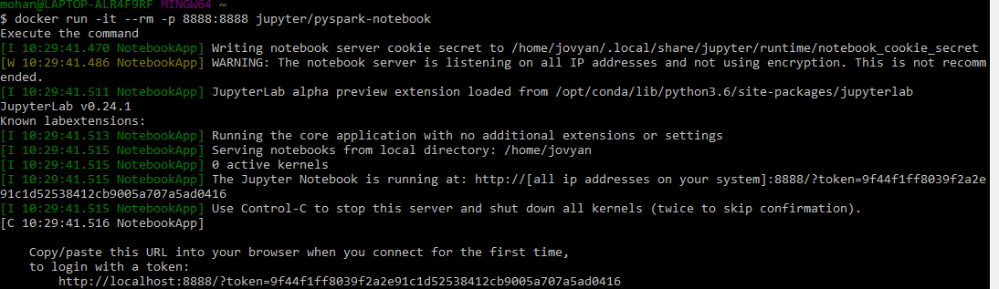
sudo docker run -it --rm -p 8888:8888 jupyter/pyspark-notebook

Slide 15
Using Spark Local Mode This configuration is nice for using Spark on small, local data. 1. Run the container as shown above. 2. Open a Python 2 or 3 notebook. 3. Create a SparkContext configured for local mode. import pyspark sc = pyspark.SparkContext('local[*]')

Slide 16
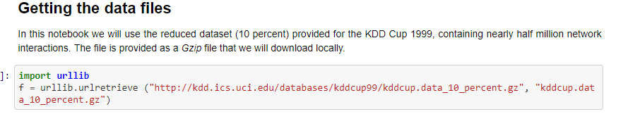
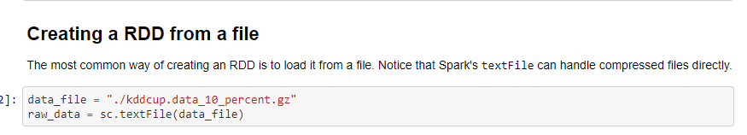
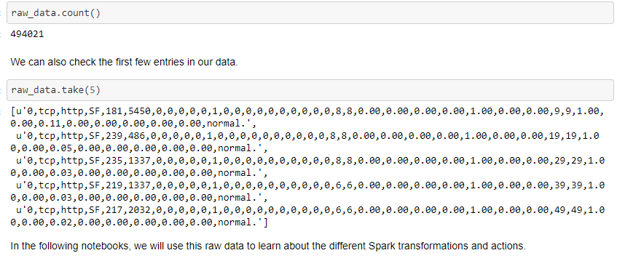

Slide 17
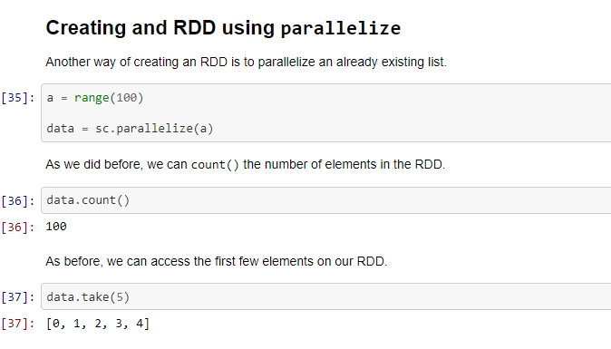

Slide 18
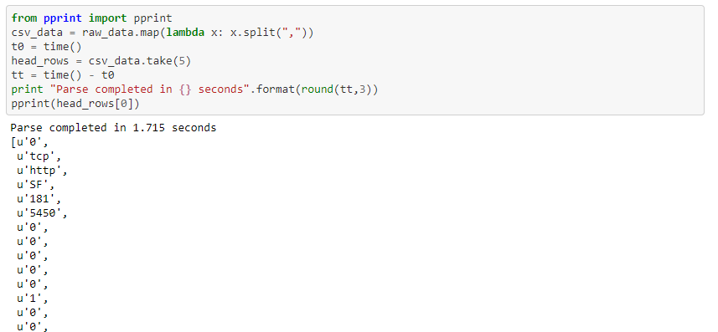
The map transformation

Slide 19
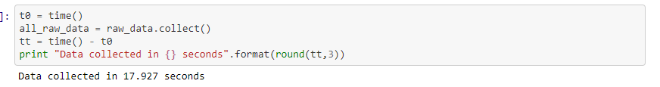
The collect action Basically it will get all the elements in the RDD into memory for us to work with them. For this reason it has to be used with care, specially when working with large RDDs.

Slide 20
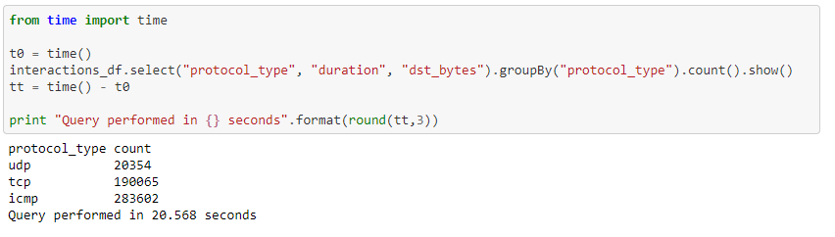
Sampling RDD
Queries as DataFrame operations

Slide 21
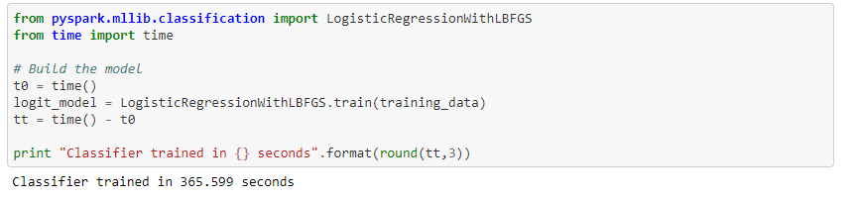
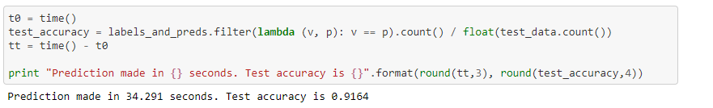
MLlib: Classification with Logistic Regression

Slide 22
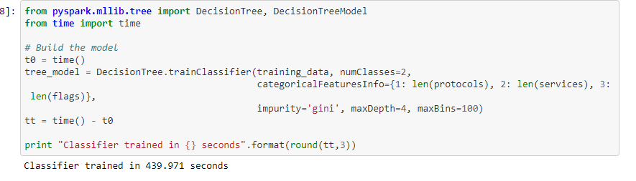
MLlib: Decision Trees

Slide 23
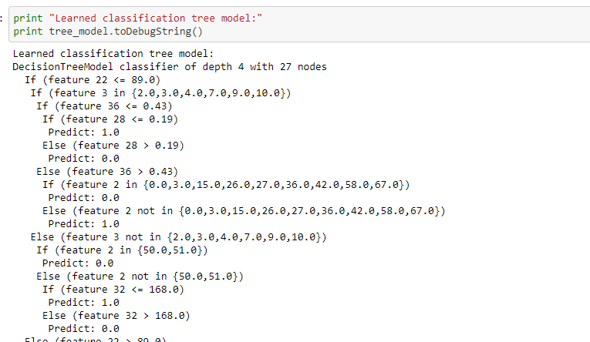
Interpreting the model

Slide 24
